Slide 1

Restaurant & Consumer Data Project Using MySQL
TEAM MEMBERS:
T.Dharani
S.Shahul Hameed
Chandana Inturu

Slide 2
Introduction
The Restaurant & Consumer Data Project analyzes interactions between consumers and restaurants using SQL. The dataset includes consumer demographics, preferences, spending habits, restaurant details, and ratings.
The project involves:
Creating and managing relational tables in MySQL
Importing and cleaning raw data
Exploring relationships with joins and subqueries
Performing advanced SQL (CTEs, views, window functions, procedures)
Deriving insights on customer preferences, restaurant performance, and cuisine trends
This project demonstrates SQL proficiency while providing business insights to improve customer satisfaction and decision-making.

Slide 3
Objective
Analyze restaurant and consumer datasets using MySQL.
Identify patterns in customer preferences, restaurant performance, and service quality.
Apply SQL joins, aggregations, subqueries, CTEs, views, and stored procedures.
Generate actionable insights to improve customer satisfaction and business decisions.

Slide 4
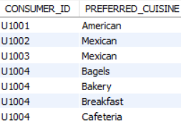
Tables
Consumer Table
Consumer_Preferences Table

Slide 5
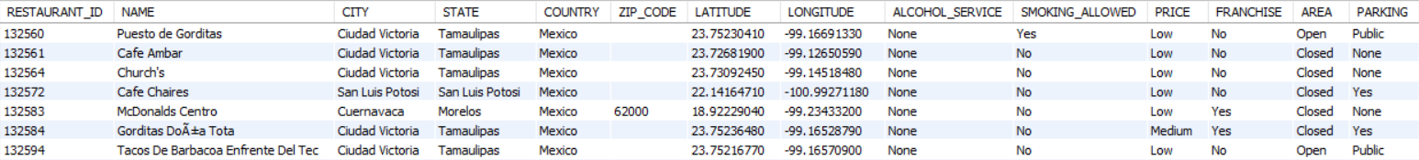
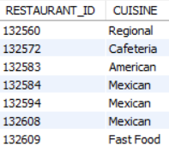
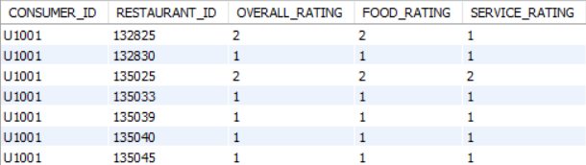
Restaurants Table
Restaurant_Cuisines Table
Ratings Table

Slide 6
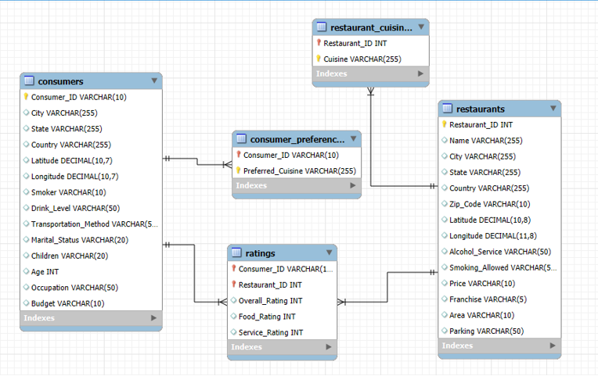
ER Diagram

Slide 7
Schema Explanation
Tables Overview
consumers – Stores demographic details of consumers, including age, gender, city, marital status, occupation, ect.
restaurants – Contains restaurant details such as name, city, types of services, parking availability, and price range.
ratings – Holds consumer reviews for restaurants, including Overall Rating, Food Rating, and Service Rating.
consumer_preferences – Lists each consumer’s preferred cuisines.
restaurant_cuisines – Lists the cuisines served by each restaurant.
data_dictionary – Describes each column and its meaning in the dataset.
Key Relationships
One Consumer → Many Ratings
A single consumer can rate multiple restaurants (consumers.Consumer_ID → ratings.Consumer_ID).
One Restaurant → Many Ratings
A single restaurant can be rated by multiple consumers (restaurants.Restaurant_ID → ratings.Restaurant_ID).
One Restaurant → Many Cuisines
A restaurant can serve multiple cuisines (restaurants.Restaurant_ID → restaurant_cuisines.Restaurant_ID).
One Consumer → Many Cuisine Preferences
A consumer can have multiple preferred cuisines (consumers.Consumer_ID → consumer_preferences.Consumer_ID).

Slide 8
Key analysis questions (use cases)
1. Customer Preferences
Which cuisines are most preferred by different age groups and occupations?
What budget categories are most common among consumers?
2. Restaurant Performance
Which restaurants have the highest average Overall Ratings?
Are restaurants with parking facilities rated higher than those without?
3. Service & Food Quality Trends
How does Food Rating compare to Service Rating for the same restaurant?
Which cities have restaurants with above-average food quality?
4. Consumer Engagement
Which consumers are most active in providing ratings?
Do students rate restaurants differently compared to employed professionals?
5. Cuisine-Specific Insights
Which Mexican restaurants receive the highest ratings?
How do ratings for Italian cuisine differ from ratings for American cuisine?

Slide 9
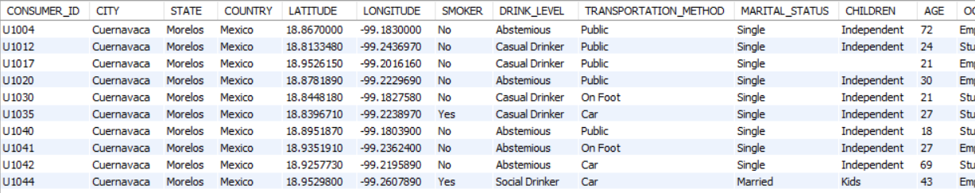
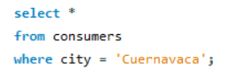
SQL query results
Using the WHERE clause to filter data based on specific criteria.
1. List all details of consumers who live in 'Cuernavaca'.
QUERY :
OUTPUT :

Slide 10
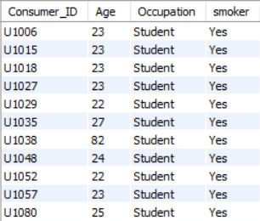
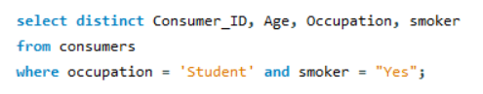
2. Find Consumer_ID, Age, and Occupation of all consumers who are 'Students' AND are 'Smokers'.
QUERY :
OUTPUT :

Slide 11
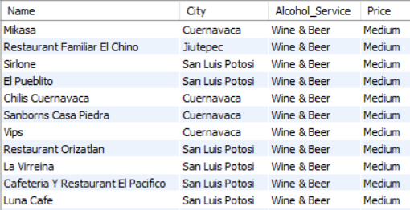
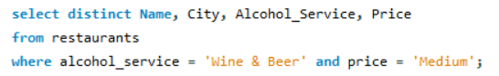
3. List the Name, City, Alcohol_Service, and Price of all restaurants that serve 'Wine & Beer' and have a 'Medium' price level.
QUERY :
OUTPUT :

Slide 12
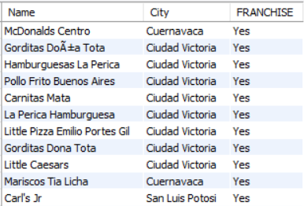
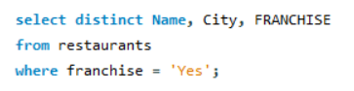
4. Find the names and cities of all restaurants that are part of a 'Franchise'.
OUTPUT :
QUERY :

Slide 13
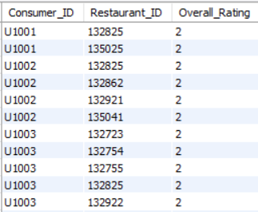
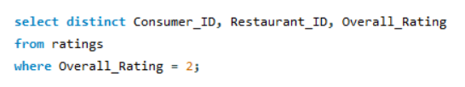
5. Show Consumer_ID, Restaurant_ID, and Overall_Rating where Overall_Rating was 'Highly Satisfactory' (value 2).
QUERY :
OUTPUT :

Slide 14
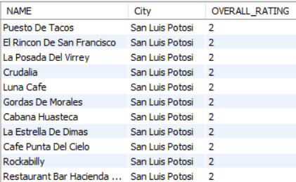
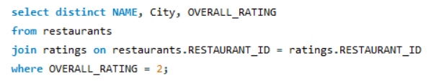
JOINs with Subqueries
1. Names and cities of restaurants with Overall_Rating = 2
QUERY :
OUTPUT :

Slide 15
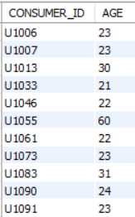
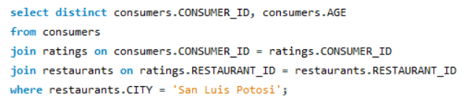
2. Consumer_ID and Age of consumers who rated restaurants in 'San Luis Potosi'
OUTPUT :
QUERY :

Slide 16
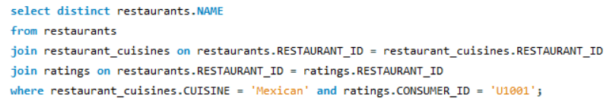
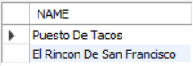
3. Restaurants serving 'Mexican' cuisine rated by consumer 'U1001'
QUERY :
OUTPUT :

Slide 17
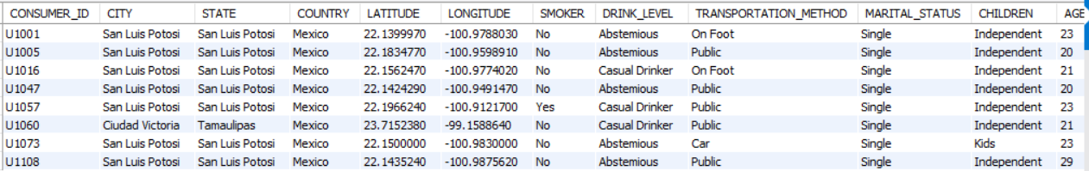
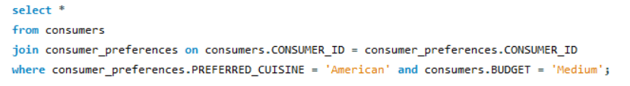
4. Consumers who prefer 'American' cuisine AND have a 'Medium' budget
QUERY :
OUTPUT :

Slide 18
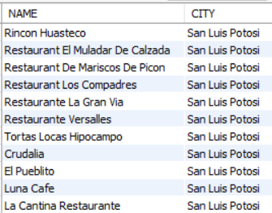
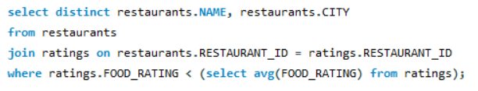
5. Restaurants with Food_Rating lower than average Food_Rating
QUERY :
OUTPUT :

Slide 19
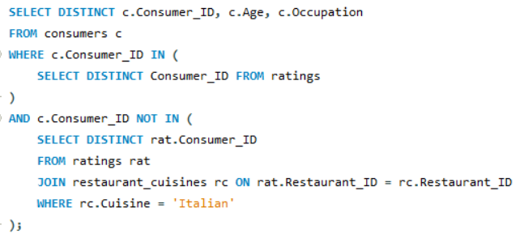
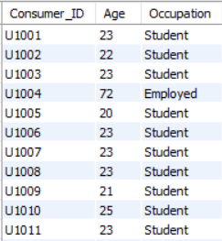
6. Consumers who rated at least one restaurant but NOT any Italian restaurant
QUERY :
OUTPUT :

Slide 20
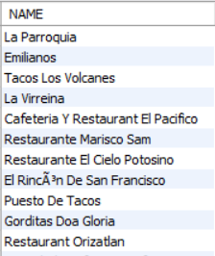
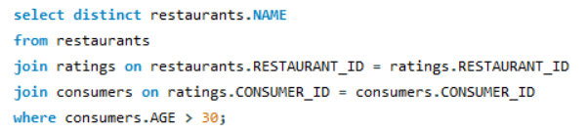
7. Restaurants rated by consumers older than 30
QUERY :
OUTPUT :

Slide 21
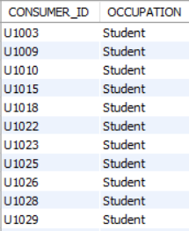
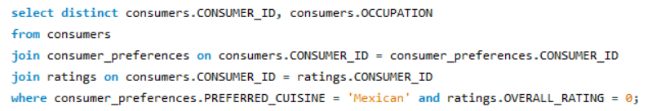
8. Consumers preferring 'Mexican' and giving Overall_Rating = 0
QUERY :
OUTPUT :

Slide 22
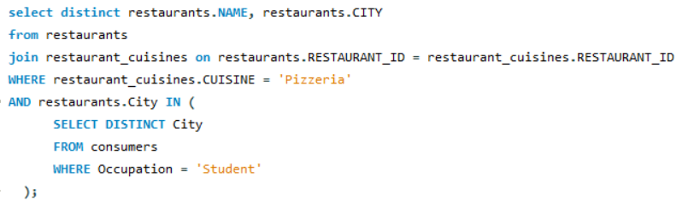
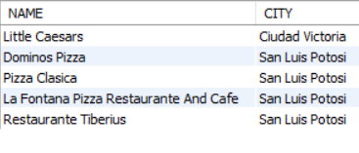
9. Pizzeria restaurants in cities where at least one Student lives
QUERY :
OUTPUT :

Slide 23
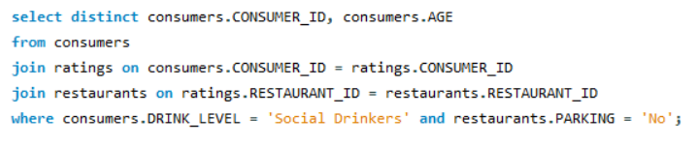
10. Social Drinkers who rated a restaurant with 'No' parking
QUERY :
OUTPUT :

Slide 24
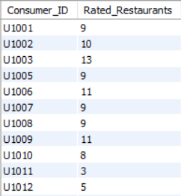
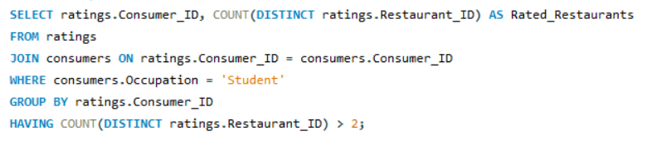
Questions Emphasizing WHERE Clause and Order of Execution
1. Students who have rated more than 2 restaurants
QUERY :
OUTPUT :

Slide 25
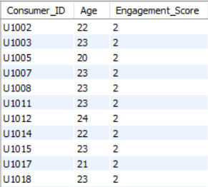
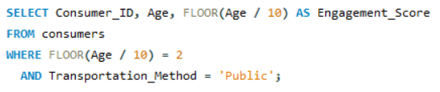
2. Consumers with Engagement_Score = 2 and using Public transportation
QUERY :
OUTPUT :

Slide 26
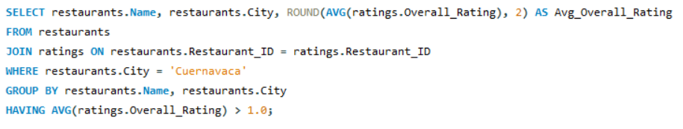
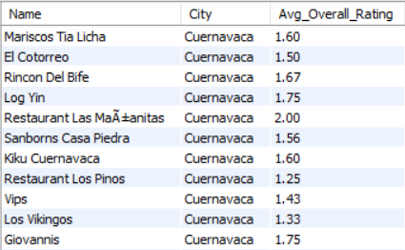
3. Average Overall_Rating for restaurants in Cuernavaca > 1.0
QUERY :
OUTPUT :

Slide 27
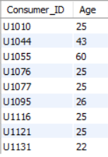
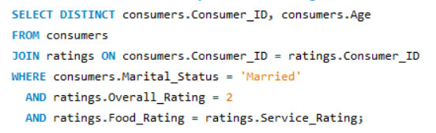
4. Married consumers where Food_Rating = Service_Rating, Overall_Rating = 2
QUERY :
OUTPUT :

Slide 28
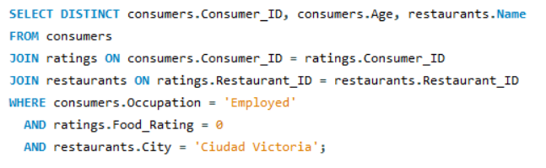
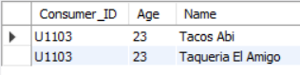
5. Employed consumers who gave Food_Rating = 0 to a restaurant in Ciudad Victoria
QUERY :
OUTPUT :

Slide 29
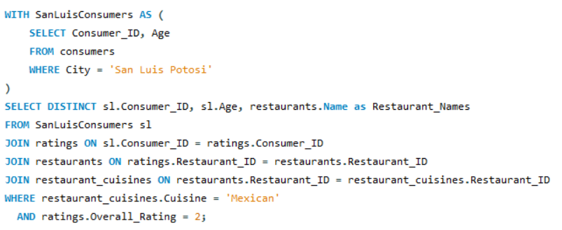
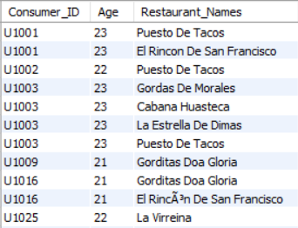
Advanced SQL Concepts: Derived Tables, CTEs, Window Functions, Views, Stored Procedures
1. CTE – Consumers in 'San Luis Potosi' and Mexican restaurants rated with Overall_Rating = 2
QUERY :
OUTPUT :

Slide 30
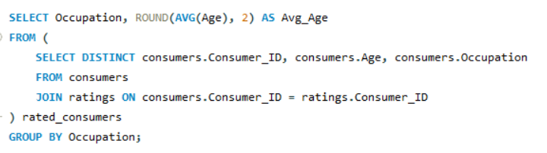
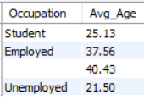
2. Derived Table – Average age per occupation (only consumers who rated)
QUERY :
OUTPUT :

Slide 31
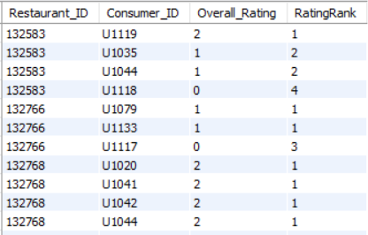
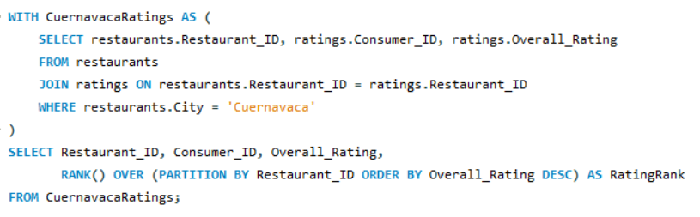
3. CTE + Window Function – Rank ratings for 'Cuernavaca' restaurants
QUERY :
OUTPUT :

Slide 32


4. Window Function – Show average rating per consumer
QUERY :
OUTPUT :

Slide 33


5. CTE + ROW_NUMBER – Students with 'Low' budget, top 3 cuisines
QUERY :
OUTPUT :

Slide 34


6. Derived Table – Ratings by Consumer U1008, with next rating
QUERY :
OUTPUT :

Slide 35


7. View – HighlyRatedMexicanRestaurants
QUERY :
OUTPUT :

Slide 36


8. CTE – Mexican cuisine lovers who have not rated any highly-rated Mexican restaurant
QUERY :
OUTPUT :

Slide 37


9. Stored Procedure – GetRestaurantRatingsAboveThreshold
QUERY :
OUTPUT :

Slide 38


10. Top 2 highest-rated restaurants for each cuisine (ties included)
QUERY :
OUTPUT :

Slide 39


11. View + CTE – Top 5 consumers by average rating & their Mexican ratings count
QUERY :
OUTPUT :

Slide 40

12. Stored Procedure – GetConsumerSegmentAndRestaurantPerformance
QUERY :

Slide 41


Slide 42

OUTPUT :

Slide 43
Final Business Insights & Recommendations
Mexican cuisine is most popular among consumers aged 25–35 → focus marketing on this segment.
Medium-priced restaurants with wine/beer receive higher ratings → maintain quality in this category.
Students and social drinkers are highly engaged → offer discounts and targeted promotions.
Restaurants with parking score better in service ratings → invest in parking facilities where possible.
American cuisine preference aligns with medium budget → set prices accordingly to attract this group.

Slide 44
My Experience & Challenges
Learning Curve: Enhanced SQL skills with joins, subqueries, CTEs, and views.
Foreign Key Dependencies: Managed table loading order to maintain relationships.
Query Optimization: Selected the most efficient approach (JOIN vs. subquery) for each task.
Complex Relationships: Understood and applied ER diagram relationships to build correct queries.
Real-World Thinking: Translated business questions into SQL queries to generate actionable insights.

Slide 45
Conclusion (Key Finding overall)
Data analysis revealed Mexican cuisine as the top preference, especially among younger consumers.
Medium-priced restaurants with wine/beer and parking facilities consistently received higher ratings.
Students and social drinkers emerged as highly active reviewers, providing valuable feedback.
Combining consumer preferences with restaurant performance helps identify target markets and guide business strategies.
The project demonstrated how SQL techniques (joins, subqueries, CTEs, views, stored procedures) can turn raw data into actionable insights.

Slide 46
Q&A
💬 Thank you for your attention.
📌 Questions are welcome!

Slide 47

THANK YOU

